Slide 1

A geo-spatial exploration and analysis of the health food market in San Francisco
IBM Applied Data Science Capstone
Final Project
Anzar A. Syed

Slide 2
Introduction

Slide 3
Background – Market Characteristics
Consumers across the world are becoming increasingly more
Health food market is booming, particularly certain segments
Overall market is expected to see growth rate of 5.7% and may see market size of USD 1,253 billion by 2024
Vegan and vegetarian market forecasts – 20% growth in the dollar sales of plant-based food in the US versus a 2% growth in overall food sales
Global organic food and beverages market will reach USD 323.56 Billion by 2024

Slide 4
Background – San Francisco Market
Amongst the leading major cities in the US and the world in the upsurge in this health-conscious food trend
Considered one of the top 5 most vegetarian and vegan friendly cities in the US by Vitacost
Best city to live the organic foodie lifestyle according to Organic Authority

Slide 5
Problem
San Francisco one of the most promising locations to venture into the health food market
However, due to rapid growth and past success, the market is highly competitive
A new venture in this market would need to:
Understand the market dynamics of different neighbourhoods
analyse the best area to be located

Slide 6
Interest
This analysis would be useful to any individuals and businesses that are interested in venturing into the health food market or associated markets in San Francisco or similar cities and would like to explore such data to help their analysis

Slide 7
Data

Slide 8
Data
Foursquare API –
to explore the features of neighbourhoods in San Francisco and to acquire data of various venue categories related to the health food market, namely Organic Grocery, Farmers Market, and Vegetarian / Vegan Restaurant
The table on: http://www.healthysf.org/bdi/outcomes/zipmap.htm for data of San Francisco neighbourhoods and their corresponding Zip codes
The python database uszipcode to get the longitude and latitude values corresponding to each zip code
The geopy geocoder class Nominatum will also be used for geocoding certain fields of data into longitude and latitude values

Slide 9
Methodology and Results

Slide 10
I started by scraping the following Wikipedia page: http://www.healthysf.org/bdi/outcomes/zipmap.htm using Beautiful and obtaining the data for neighborhoods in San Francisco and their corresponding Zip Codes in the table as a dataframe
In order to utilize Foursquare location data, I needed to get the latitude and the longitude coordinates of each neighbourhood
I used the Python database uszipcode and its function SearchEngine to acquire this and the geopy geocoder class Nominatum was also be used for geocoding the address San Francisco into longitude and latitude values

Slide 11
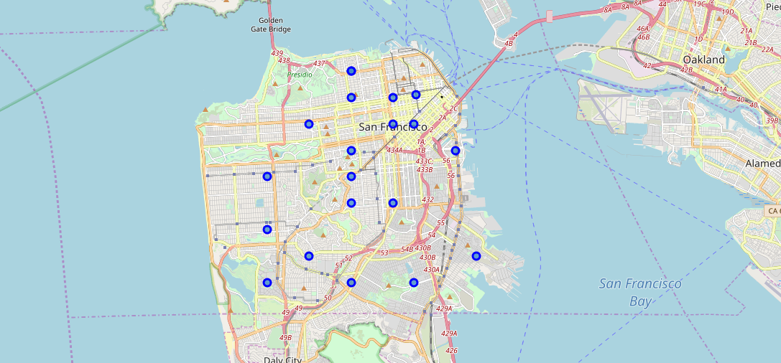
I then used the Folium Library to visualize the geo-spatial data of neighbourhoods of San Francisco on the following map of San Francisco neighbourhoods::

Slide 12
After this I connected with the Foursquare API to begin the actual analysis. I began by getting data of the top 100 venues in a 500 metre radius of the centre of the neighbourhoods from the Foursquare API and organising it.
This was followed by one-hot encoding, which is process to turn the qualitative data into quantitative data for further analysis, and the grouping the resultant data by neighbourhood.

Slide 13
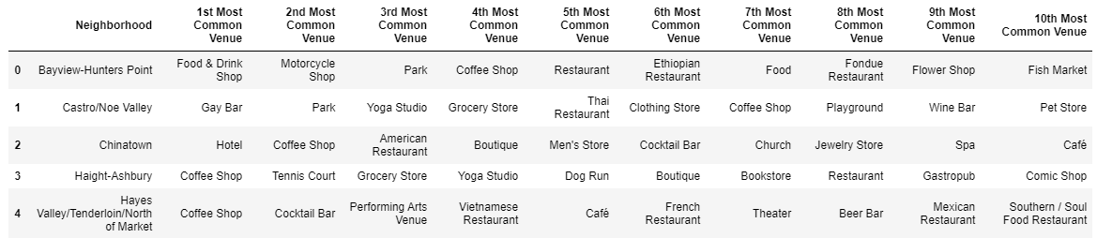
I then ran some code to see the top 10 most common venue categories for each neighbourhood. This gave us the following dataframe:

Slide 14
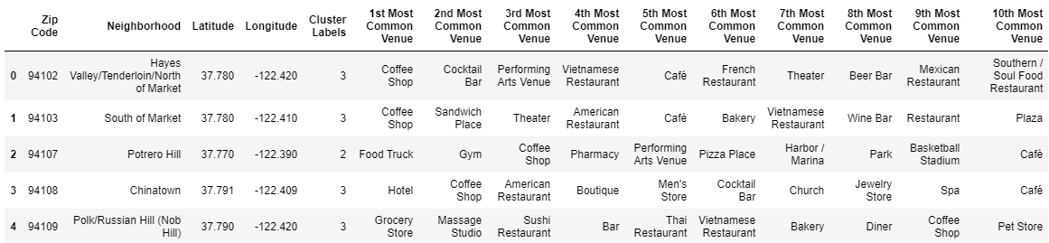
I then wanted to segment and cluster the data gathered and analysed so far. To do so I first merged the dataframe above with the dataframe of geo-spatial data of Zip Codes, Longitudes and Latitudes that I had created earlier. The resultant dataframe was as follows:

Slide 15
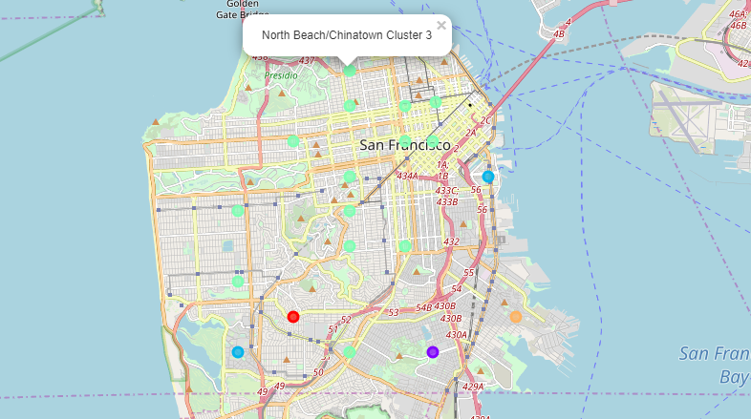
The next step was visualizing the clusters on a map using Folium:

Slide 16
This was followed by examining each cluster in more detail. Clusters 2 and 3 stood out amongst the rest
Neighbourhoods in these clusters have similar venues and features. This will help in further analysis
I then make a new dataframe with only the venue categories mentioned earlier that are of interest to us for our analysis and cluster this data into 5 clusters to compare with the overall neighbourhood clusters and try to gain some insights.

Slide 17
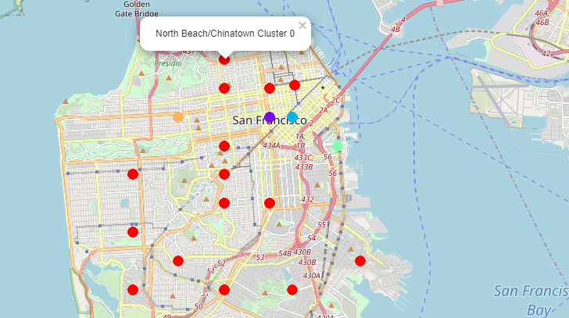
To do so, as shown earlier I merge this dataframe with the earlier dataframe of geo-spatial data of Zip Codes, longitudes and latitudes to create a new dataframe. This new dataframe is used to create a map of the clusters of neighbourhoods with similar health food venues based on the related venue categories we selected:

Slide 18
Discussion

Slide 19
Discussion
As we can see from the map, there are several differences between the clusters generated of the overall neighbourhoods and those generated when focusing on the health food related categories we focused on

Slide 20
Discussion
The neighbourhoods of Hayes Valley/Tenderloin/North of Market, South of Market and Inner Richmond are all part of the same biggest cluster, cluster 3 of the neighbourhoods overall, but when evaluated on health food venue categories, they all stand alone as distinct and dissimilar clusters
Similarly, Lake Merced, which overall is more similar to Potrero Hill, here stands as part of Cluster 0, the largest cluster of neighbourhoods similar in terms heath food venues
The neighbourhoods of Bayview-Hunters Point, Visitacion Valley/Sunnydale and St. Francis Wood/Miraloma/West Portal are all also part of Cluster 0 here and similar in terms of health food venues, whereas in terms of overall venues and similarity they are all unique.

Slide 21
These insights can prove to be very useful in determining a successful location for a new health food venture by a business or entrepreneur or to determine the potential for a new similar or related venue in a particular neighbourhood.
They uncover some interesting findings, such as neighbourhoods which may currently be underserved and where there exists a higher possibility of success for a new venture as well as neighbourhoods with similar overall traits and consumer behaviour but where the health food market has yet to maturely develop.

Slide 22
Conclusion

Slide 23
Conclusion
The results of out analysis hold important insights into the geographical concentration and saturation of the health food market in San Francisco at a neighbourhood level.
As always however, this analysis is however limited by the limitation of the data and parameters used.

Slide 24
Conclusion
A greater number of parameters such as a higher number of top venues, a larger radius, more categories of venues and other forms of data such as resident demographics and consumer behaviour
Inclusion of non-food venues related to health food such as gyms and yoga studios could also be useful to the analysis
A comparison with cities with similar health food trends to those of San Francisco could also be useful to improve the rigour of the analysis

Slide 25
To find out more about the project:
The full project report:
https://github.com/anzarsyed/applied-data-science-capstone/blob/master/Project%20Report%20Applied%20Data%20Science%20Capstone%20-%20W5.pdf
The Jupyter Notebook used for the code:
https://github.com/anzarsyed/applied-data-science-capstone/blob/master/Capstone%20Notebook%20-%20W5.ipynb

